Slide 1


micro:bit entry video tutorial
Lesson 5
micro:bit basic lesson 5 “Direction follower”
YahBoom micro:bit video tutorial

Slide 2
micro:bit entry video tutorial
Content
Part1
Part 2
Part3
Part 4
Part 5
Learning goals
Preparation
Search for blocks
Combine blocks
Have a try
YahBoom micro:bit video tutorial

Slide 3
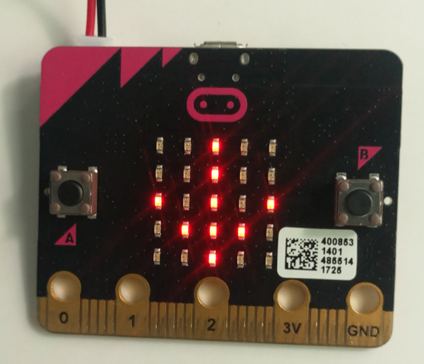
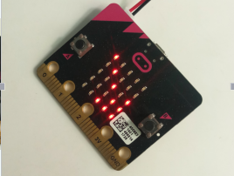
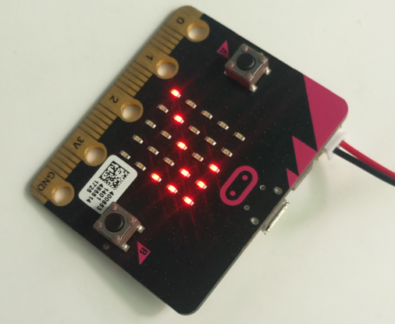
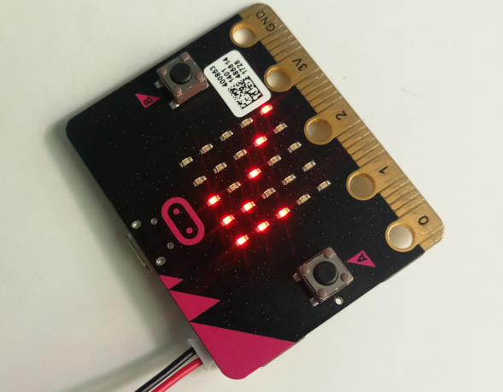
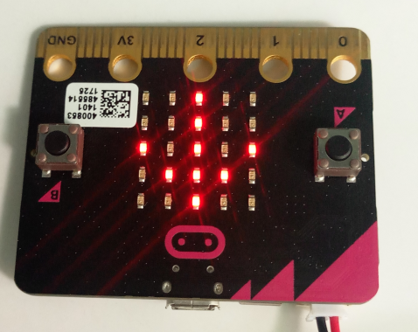
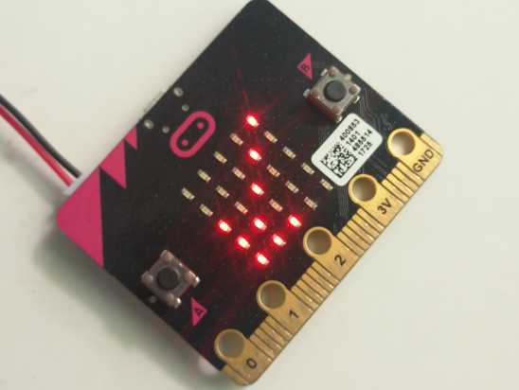
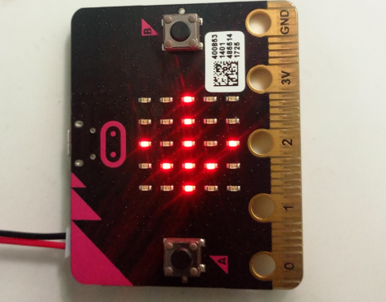
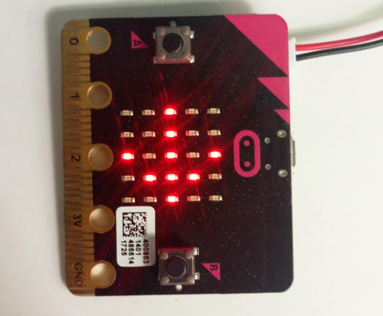
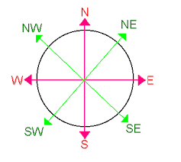
micro:bit entry video tutorial
Part 1
Learning goals
After downloading the program, the bit development board can be swung to the east, west, south, north, northeast, northwest, southeast, southwest eight different directions. You can see that no matter which direction the micro:bit swings, the pointer on the dot will point to this direction.
YahBoom micro:bit video tutorial

Slide 4
micro:bit entry video tutorial
Part 2
Hardware:
● 1 X Micro: bit Board
● 1 X Micro USB Cable
● 2 X AAA batteries
Preparation
Then the micro:bit is connected to the computer through USB, and the computer will pop up a U disk and click the URL in the U disk to enter the programming interface.
YahBoom micro:bit video tutorial

Slide 5
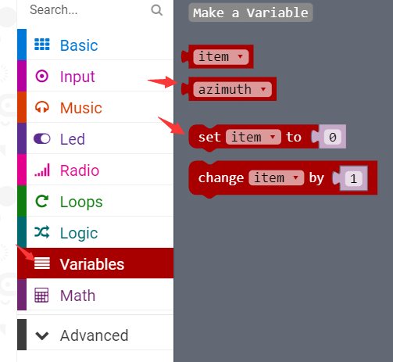
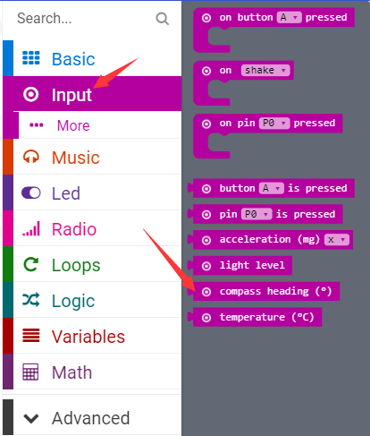
micro:bit entry video tutorial
Part 3
Search for blocks
compass heading "the direction of the compass",
In micro:bit, we use the degree to indicate its direction by default.
YahBoom micro:bit video tutorial

Slide 6
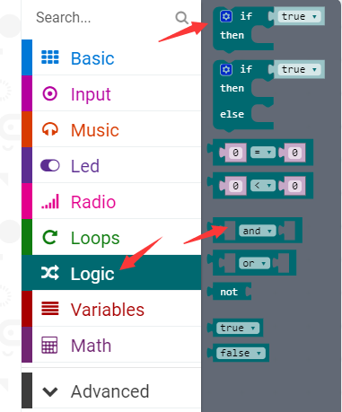
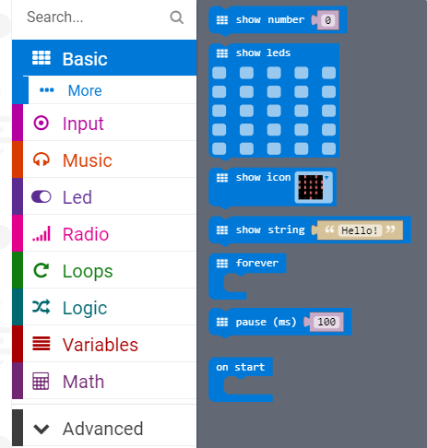
micro:bit entry video tutorial
Part 3
Search for blocks
YahBoom micro:bit video tutorial

Slide 7
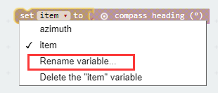

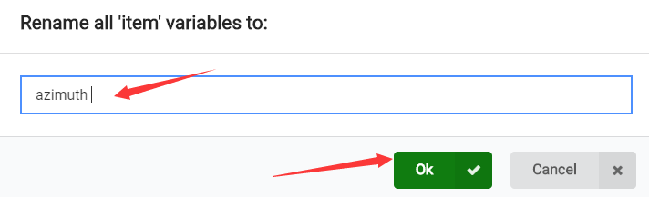
micro:bit entry video tutorial
Part 3
Search for blocks
YahBoom micro:bit video tutorial

Slide 8
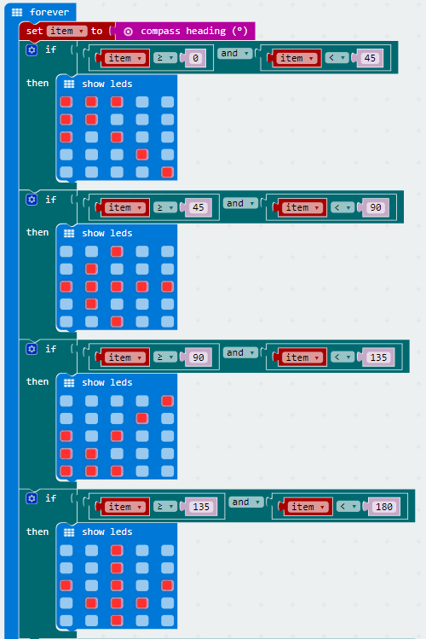
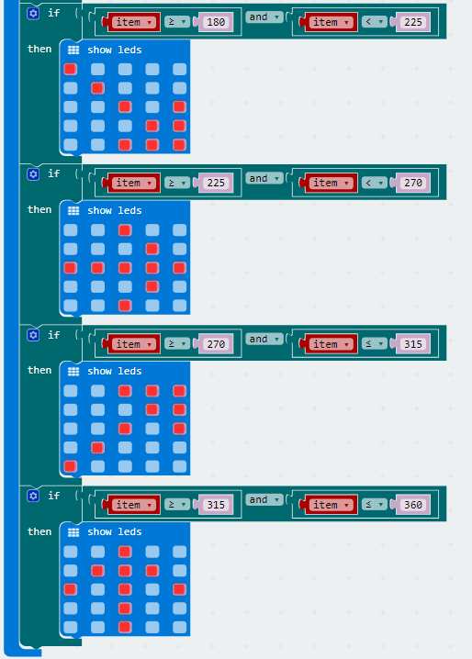
micro:bit entry video tutorial
Part 4
Combine blocks
The right blocks follow with the left
YahBoom micro:bit video tutorial

Slide 9
micro:bit entry video tutorial
Part 4
After downloading the program, we need to calibrate the compass for normal use.
The calibration method is:
We need to bias the micro:bit in different directions, illuminate all the LED lights on the LED dot matrix, and a smile appears, indicating that the calibration is successful. We can use the micro:bit compass normally.
!!!Note
YahBoom micro:bit video tutorial

Slide 10


micro:bit entry video tutorial
Part 5
Do you learn the course today?
If you learn to do it, give yourself a top quack.
Now give you a homework assignment.
Today, our content is a simple compass, the compass is one of the four great inventions of ancient China. Let's go and find out what the other three of the four great inventions of ancient China are.
Start your little brain. Try it.
Have a try
YahBoom micro:bit video tutorial

Slide 11
micro:bit entry video tutorial
micro:bit
project
Thanks for watching！
Powered by YahBoom
YahBoom Micro:bit video tutorial

